Slide 1
UNIT – 1
Review of Network Models and Switching and Ethernet

Slide 2
    1-4 INTERNET HISTORY
Now that we have given an overview of the Internet and its protocol, let us give a brief history of the Internet.
This brief history makes it clear how the Internet has evolved from a private network to a global one in around fifty years.
1.<number>
Notes:
1.#

Slide 3
1.4.1 Early History
There were some communication networks, such as telegraph and telephone networks, before 1960. These networks were suitable for constant-rate communication at that time, which means that after a connection was made between two users, the encoded message (telegraphy) or voice (telephony) could be exchanged.
A computer network, on the other hand, should be able to handle bursty data, which means data received at variable rates at different times. The world needed to wait for the packet-switched network to be invented.
1.<number>
Notes:
1.#

Slide 4
Early History
Birth of Packet-Switched Networks :
1961 introduction of the term bursty Traffic (VBR) by MIT
In 1967 idea of ARPANET (Advanced Research Projects Agency Network) was presented (idea is to connect computers from different manufacturers to share research findings) and in 1969 it becomes a reality
It uses a special computer called IMP (Interface Message Processor) and uses a software called NCP (Network Control Protocol)
Four nodes(UCSB, UCLA, Stanford research institute and University of Utah) got connected in 1969.
1.<number>

Slide 5
1.4.2 Birth of the Internet
In 1972, Vint Cerf and Bob Kahn, both of whom were part of the core ARPANET group, wanted to link dissimilar networks so that a host on one network could communicate with a host on another.(Internetworking project)
There were many problems to overcome: diverse packet sizes, diverse interfaces, and diverse transmission rates, as well as differing reliability requirements.
Cerf and Kahn devised the idea of a device called a gateway to serve as the intermediary hardware to transfer data from one network to another.
1.<number>
Notes:
1.#

Slide 6
Birth of the Internet – TCP/IP
1973 – a paper on end to end delivery of data using a new version of NCP and named it as TCP (Transmission Control Protocol)
In 1977 Internet consisting of 3 different network was demonstrated
Shortly TCP was split into two protocols TCP and IP
New combination is known as TCP/IP
In 1981 TCP/IP was added to Berkeley Unix OS
In 1983 TCP/IP became an official protocol for networking
In 1983 ARPANET split into Military Network (MILNET) for military users and ARPANET for normal users
1.<number>
Notes:
1.#

Slide 7
1.3.3 Birth of the Internet (continued)
CSNET : Created in 1981 to connect Universities of US and funded by NSF
NSFNET : Created in 1986 by NSF
It is the Backbone to connect 5 supercomputers to all other community networks (concept of Backbone)
In 1990 ARPANET officially retired and replaced by NSFNET.
ANSNET: (Advanced Network Services Network) In 1991 a high speed Internet backbone was created to handle the increased Internet Traffic
1.<number>
1.<number>
Notes:
1.#

Slide 8
1.3.3 Internet Today
Today, we witness a rapid growth both in the infrastructure and new applications.
What has made the Internet so popular is the invention of new applications.
World Wide Web: Invented in 1991 by Tim Berners-Lee, leads to explosion of Internet applications
1995 – 2000 is the very important period
Multimedia applications: Voice over IP, Skype (Video over IP), YouTube(View sharing) , pplive (Television over IP)
Peer-to-Peer Applications
1.<number>
Notes:
1.#

Slide 9
    1-5 STANDARDS AND ADMINISTRATION
In the discussion of the Internet and its protocol, we often see a reference to a standard or an administration entity.
In this section, we introduce these standards and administration entities.
1.<number>
Notes:
1.#

Slide 10
1.4.1 Internet Standards
An Internet standard is a thoroughly tested specification that is useful to and adhered to by those who work with the Internet.
It is a formalized regulation that must be followed.
There is a strict procedure by which a specification attains Internet standard status.
1.<number>
1.<number>
Notes:
1.#

Slide 11
1.4.1 Internet Standards
A specification begins as an Internet draft
An Internet draft is a working document (a work in progress) with no official status and a six-month lifetime.
Upon recommendation from the internet authorities a draft may be published as a RFC
Each RFC is edited, assigned a number and made available to all interested people. They go through different maturity levels
1.<number>
1.<number>
Notes:
1.#

Slide 12
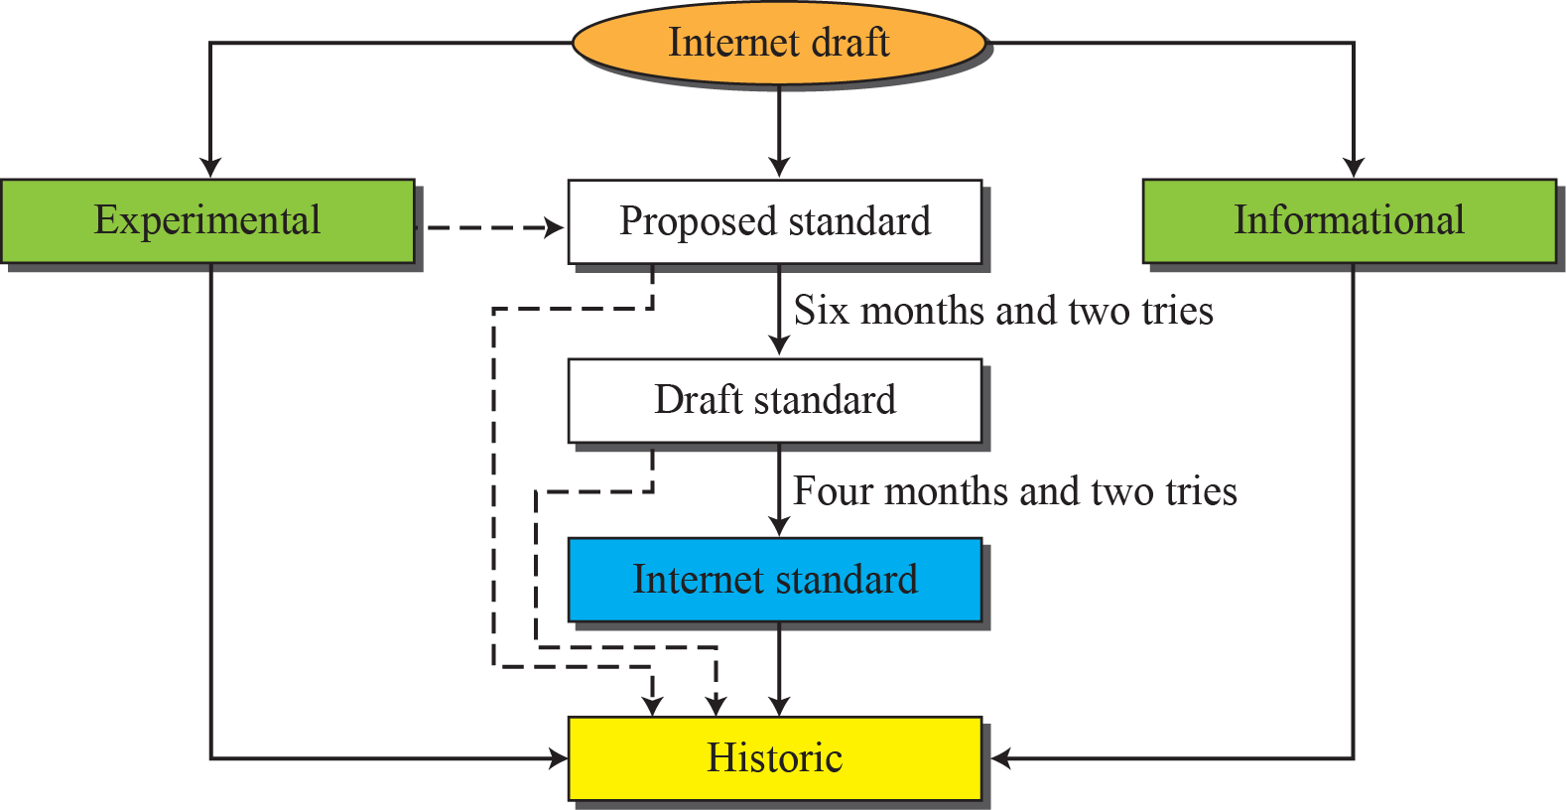
Figure 1.16: Maturity levels of an RFC
There are six maturity levels
1.<number>
Notes:
1.#

Slide 13
1.4.1 Internet Standards (Continued)
Maturity Levels of an RFC
  Proposed Standard : Stable and Well understood specification (tested and implemented by several groups)
Draft Standard: after two successful independent and interoperable implementation (six months period), Some modifications may be specified.
Internet Standard : After demonstration of successful implementation (Four months period)
Historic - those who never passed the necessary maturity levels or superseded by later specifications
Experimental : work related to experimental situation that does not affect the operations of the internet
Informational : general tutorial information
1.<number>
1.<number>
Notes:
1.#

Slide 14
1.4.1 Internet Standards (Continued)
Requirement Levels of RFC
Required – Must be implemented by all Internet systems (IP, ICMP)
Recommended – not required but recommended for usefulness (FTP, TELNET)
Elective – optional(for own benefits)
Limited Use – used in limited situations
Not Recommended - inappropriate
Look for RFC’s in http://www.rfc-editor.org
1.<number>
1.<number>
Notes:
1.#

Slide 15
1.4.2 Internet Administration
The Internet, has its roots primarily in the research domain,
It has evolved and gained a broader user base with significant commercial activity.
Various groups that coordinate Internet issues have guided this growth and development.
1.<number>
1.<number>
Notes:
1.#

Slide 16
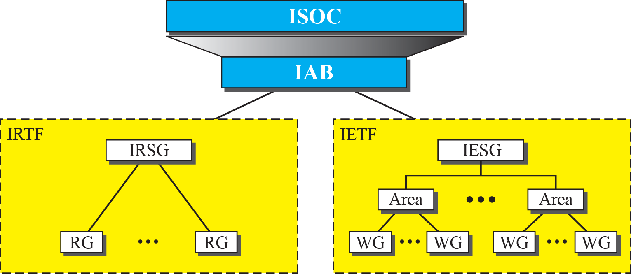
Figure 1.17: Internet administration
1.<number>
Notes:
1.#

Slide 17
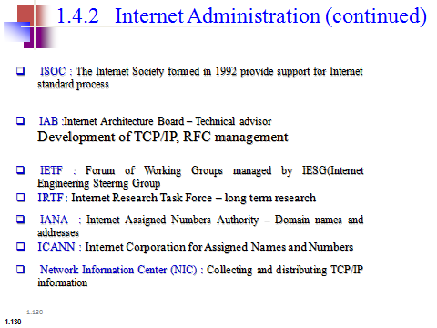
Internet Administration (continued)
1.<number>

Slide 18
    1-2 PROTOCOL LAYERING
A word we hear all the time when we talk about the Internet is protocol.
A protocol defines the rules that both the sender and receiver and all intermediate devices need to follow to be able to communicate effectively. When communication is simple, we may need only one simple protocol; when the communication is complex, we need a protocol at each layer, or protocol layering.
1.<number>
Notes:
1.#

Slide 19
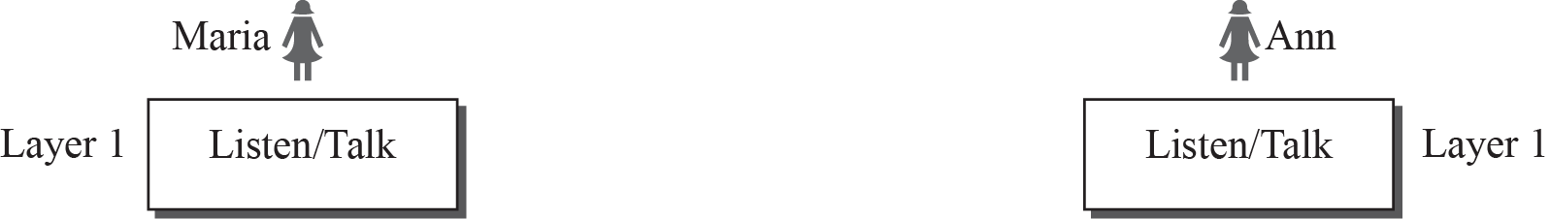
Figure 1.9: A single-layer protocol
Monolog v/s Dialog
Classroom lecture v/s chatting with friends
1.<number>
Notes:
1.#

Slide 20
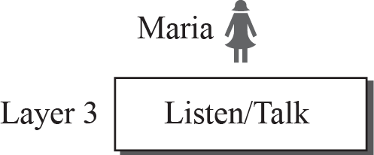
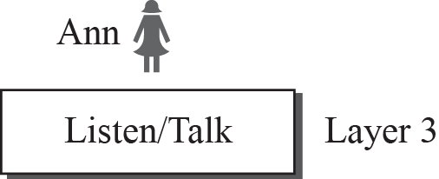
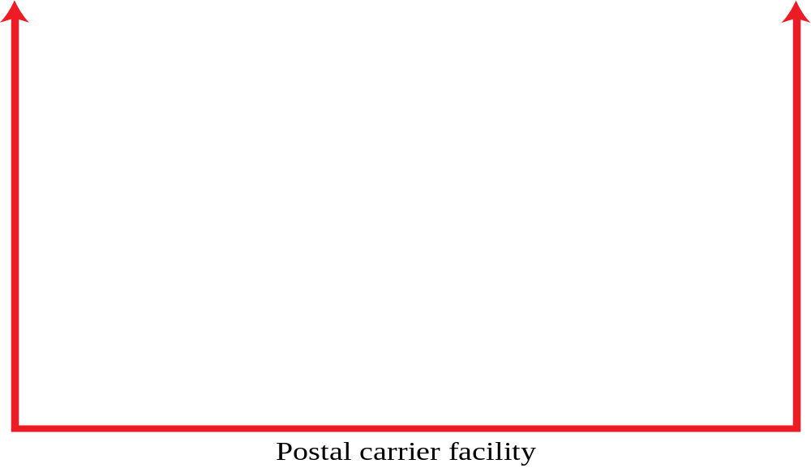

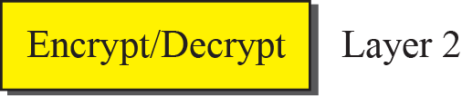
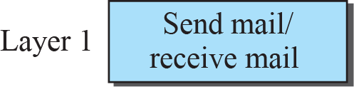
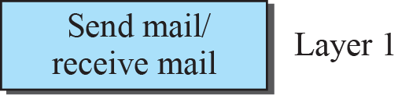
Figure 1.10: A three-layer protocol
1.<number>
Notes:
1.#

Slide 21
Why protocol layering (advantages)
protocol layering enables us to divide a complex task into several smaller and simpler tasks
Provides modularity (changing a module is easy)
It separates services from implementation
All nodes (eg. Routers) does not require all layers

Slide 22
Principles of protocol Layering
1) If we want bidirectional communication, we need to make each layer so that it is able to perform two opposite tasks, one in each direction.
2) Two objects under each layer at both sites should be identical

Slide 23
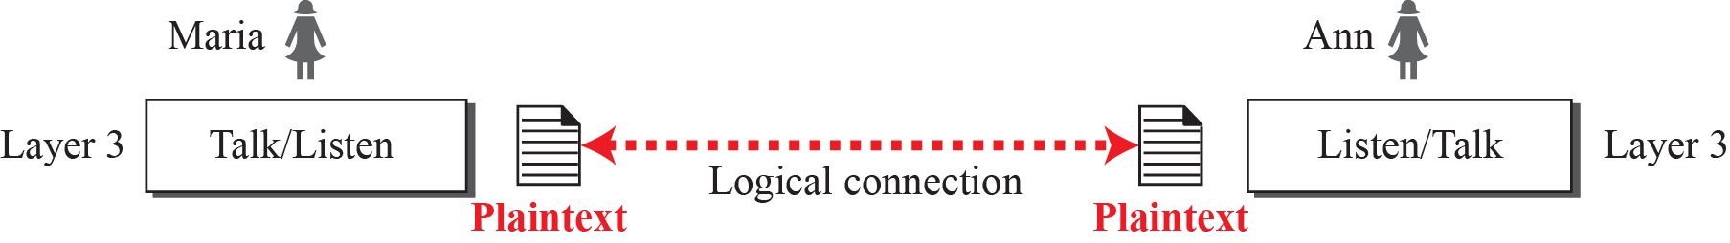
Figure 1.11: Logical connection between peer layers
1.<number>
Notes:
1.#

Slide 24
1.2.2 TCP/IP Protocol Suite
TCP/IP is a protocol suite used in the Internet today. It is a hierarchical protocol made up of interactive modules, each of which provides a specific functionality.
The term hierarchical means that each upper level protocol is supported by the services provided by one or more lower level protocols.
The original TCP/IP protocol suite was defined as four software layers built upon the hardware. Today, however, TCP/IP is thought of as a five-layer model.
1.<number>
Notes:
1.#

Slide 25
Figure 1.12: Layers in the TCP/IP protocol suite
1.<number>
Notes:
1.#

Slide 26
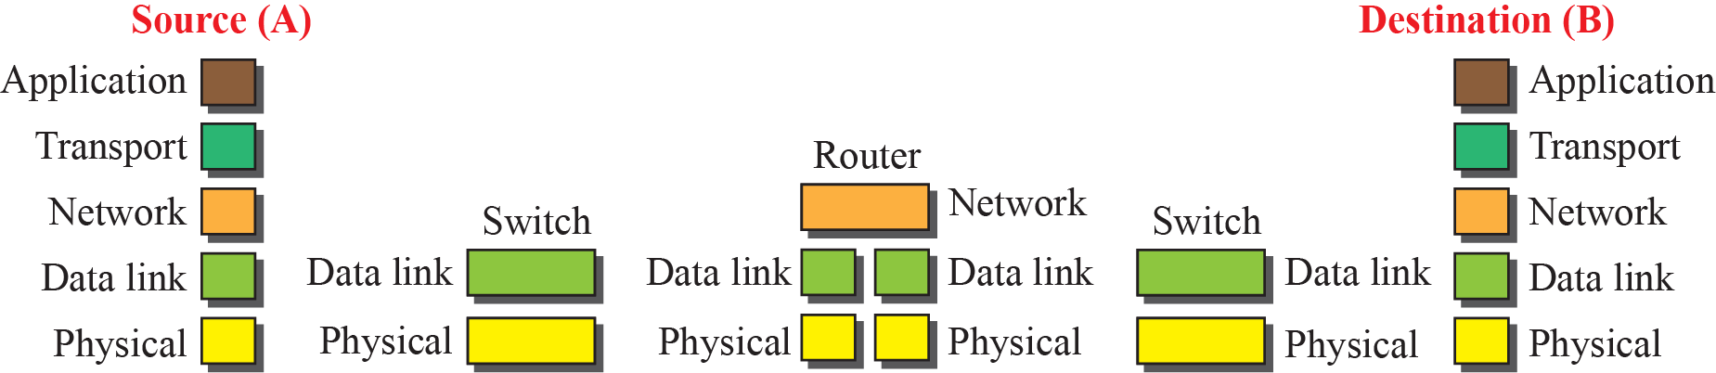

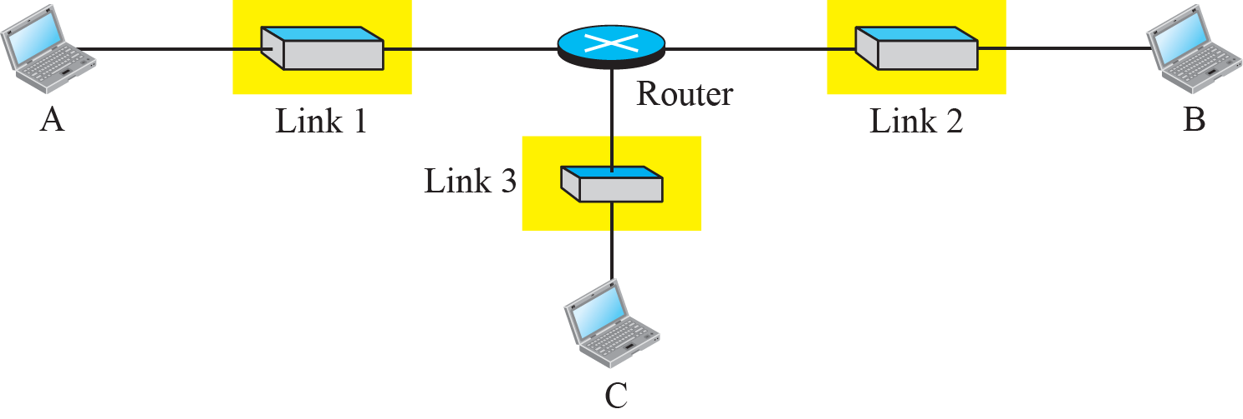
Figure 1.13: Communication through an internet
1.<number>
Notes:
1.#

Slide 27
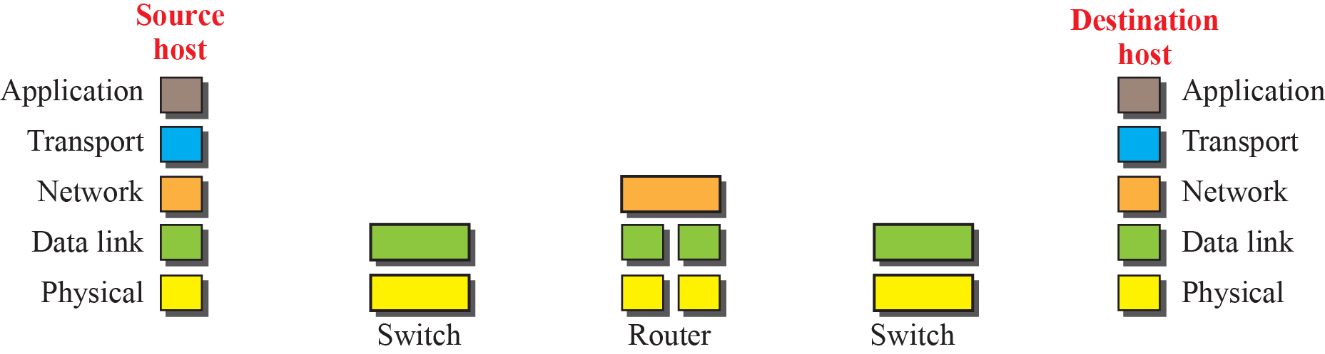
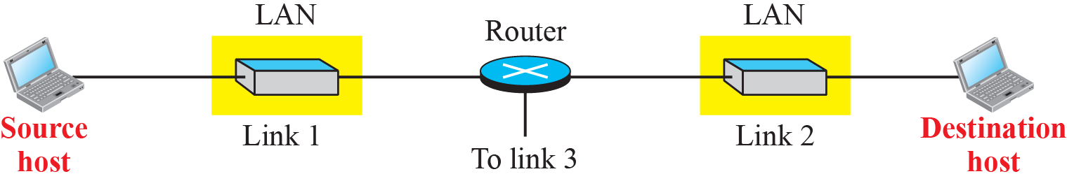
Figure 1.14: Logical connections between layers in TCP/IP
Logical connections
1.<number>
Notes:
1.#

Slide 28
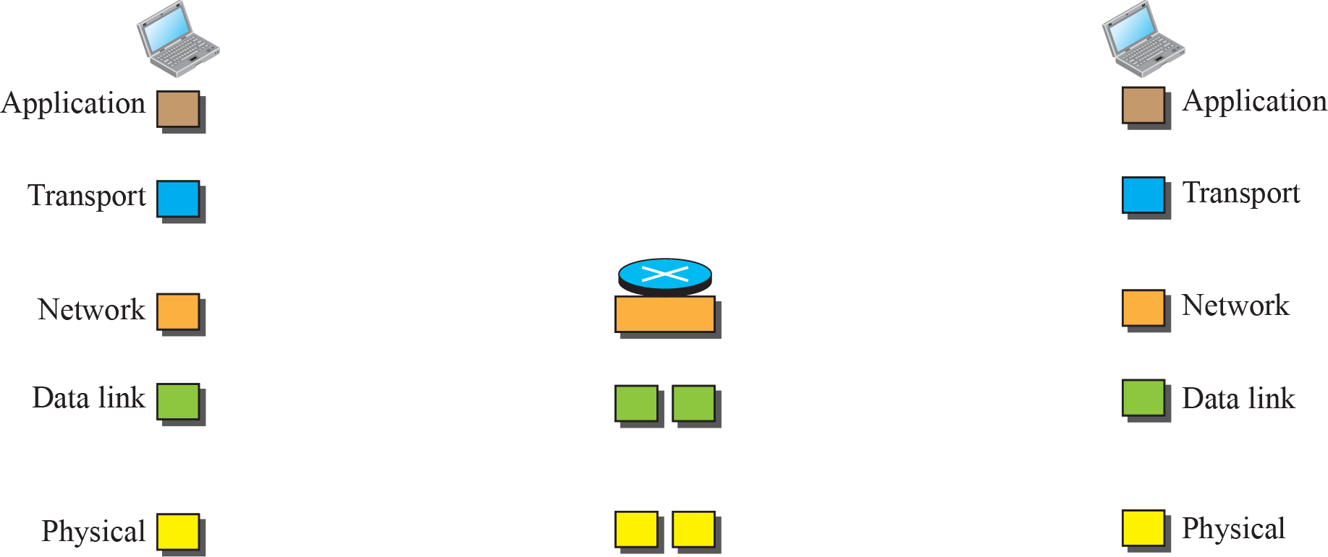
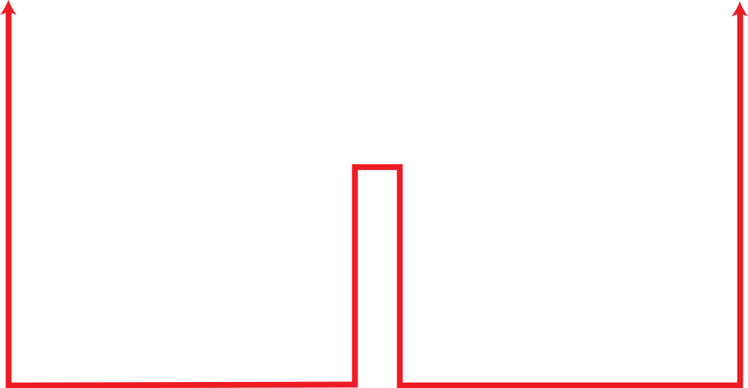
Figure 1.15: Identical objects in the TCP/IP protocol suite
Identical objects (messages)
Identical objects (segment or user datagram)
Identical objects (datagram)
Identical objects (datagram)
Identical objects (frame)
Identical objects (frame)
Identical objects (bits)
Identical objects (bits)
1.<number>
Notes:
1.#

Slide 29
Description of each layer in TCP/IP
application: Logical connection is end-to-end
Communication is between two running programs
They exchange messages
supporting network applications
  FTP, SMTP, HTTP, TELNET (Terminal Network), SSH(Secure Shell), SNMP, DNS, IGMP, DHCP

Slide 30
Description of each layer in TCP/IP
transport: Transport Layer at the source host gets the message from the application layer, encapsulates it in a segment/user datagram and send it through the logical connection
Transport Layer is independent of application layer
process-process data transfer
  TCP (Connection oriented), UDP(Connectionless), SCTP(new Multimedia applications)
  TCP provides flow control, error control and congestion control
  UDP suitable for small messages

Slide 31
Description of each layer in TCP/IP
network: It is responsible for creating connection from source computer to destination computer
Host-to-Host connectivity
Choosing the best path for each packet
routing of packets through possible routes
  Addressing
  Routing
  IP(main protocol), routing protocols(Unicast, Multicast), Companion Protocols (ICMP, IGMP, ARP)

Slide 32
Description of each layer in TCP/IP
link: data transfer between neighboring network elements (through the link)
  Ethernet, 802.11 (WiFi), PPP
  Unit of data transfer is called a Frame
  Error detection and correction, flow control
physical: bits “on the wire”
- Physical layer protocols transform the bits into signals that flows through the medium

Slide 33
1.2.2 TCP/IP Protocol Suite (continued)
Encapsulation and Decapsulation
Encapsulation at the Source Host – message-segment-packet(Datagram)-Frames-bits
Decapsulation and Encapsulation at Router
Decapsulation at the Destination Host
1.<number>
Notes:
1.#

Slide 34
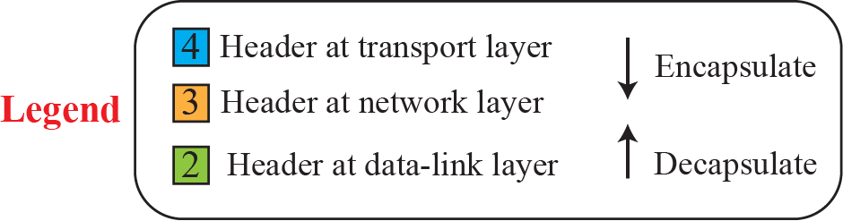
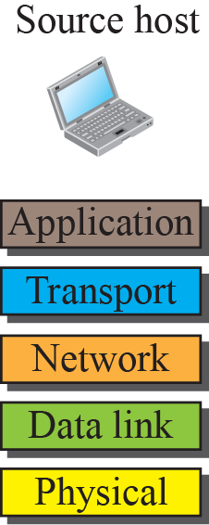
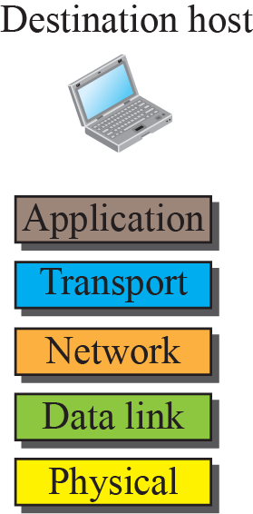

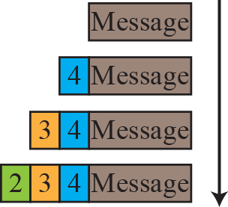
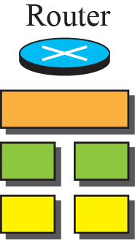
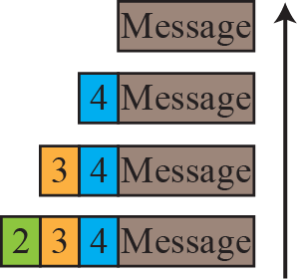
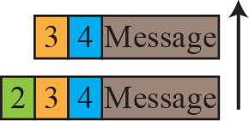
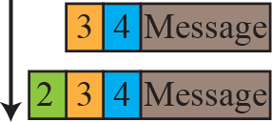
Figure 1.16: Encapsulation / Decapsulation
1.<number>
Notes:
1.#

Slide 35
Addressing
Addressing
- Any communication between two parties needs two addresses
- We have four pairs of addresses

Slide 36


Figure 1.17: Addressing in the TCP/IP protocol suite
1.<number>
Notes:
1.#

Slide 37
Multiplexing and Demultiplexing
Multiplexing – a protocol at a layer can encapsulate a packet from several next higher layer protocols
Demultiplexing – a protocol can decapsulate and deliver a packet to several next higher layer protocols

Slide 38
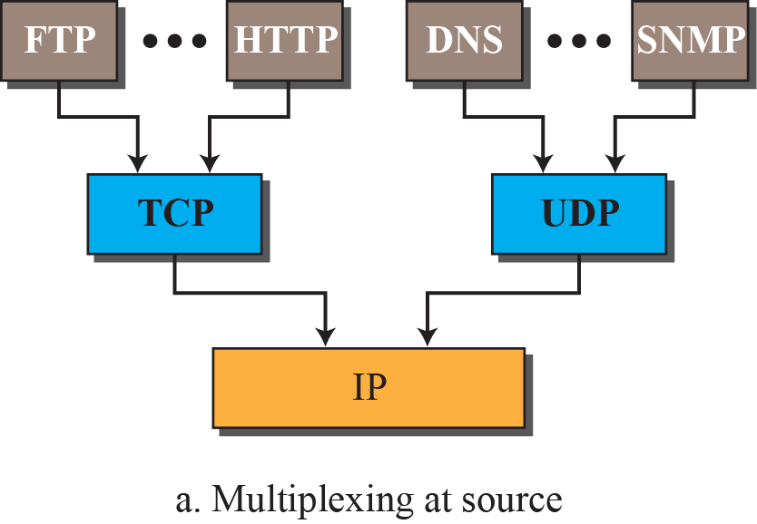
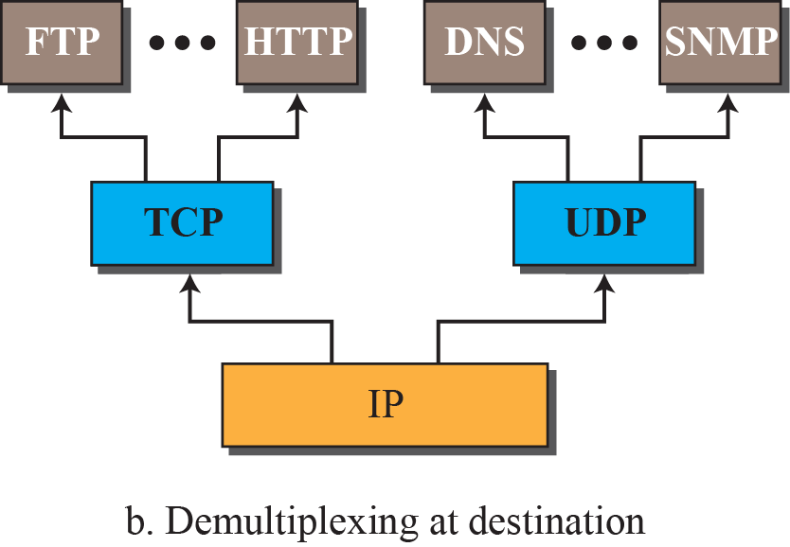
Figure 1.18: Multiplexing and demultiplexing
1.<number>
Notes:
1.#

Slide 39
1.2.2 The OSI Model
Established in 1947, ISO is a multinational body dedicated to worldwide agreement on international standards. An ISO standard that covers all aspects of network communications is the Open Systems Interconnection (OSI) model. It was first introduced in the late 1970s.
- Open : Two different systems can communicate regardless of their underlying architecture
1.<number>
Notes:
1.#

Slide 40
1.2.2 The OSI Model
OSI versus TCP/IP: 2 layers are missing
- some functionalities of session layer may be available in some of the transport layer protocol
- application layer is not just one piece, many applications could be there.
1.<number>
Notes:
1.#

Slide 41
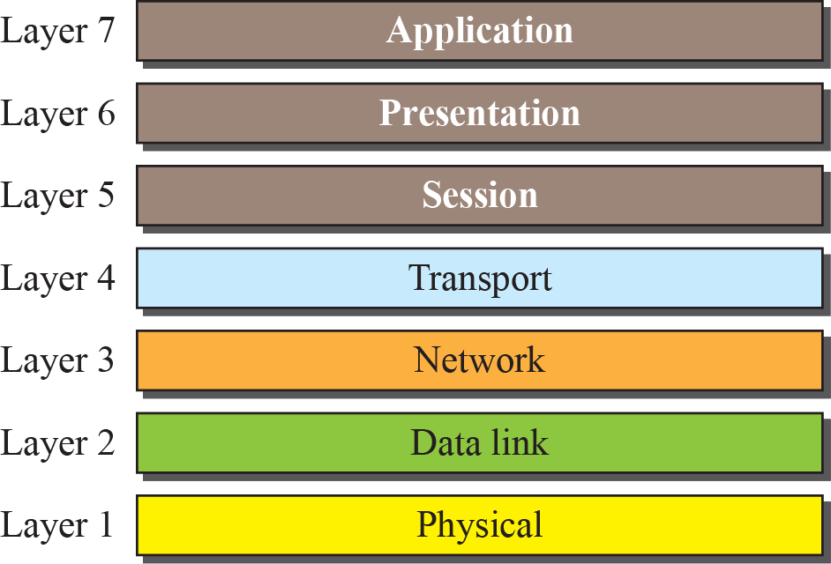
Figure 1.19: The OSI model
1.<number>
Notes:
1.#

Slide 42
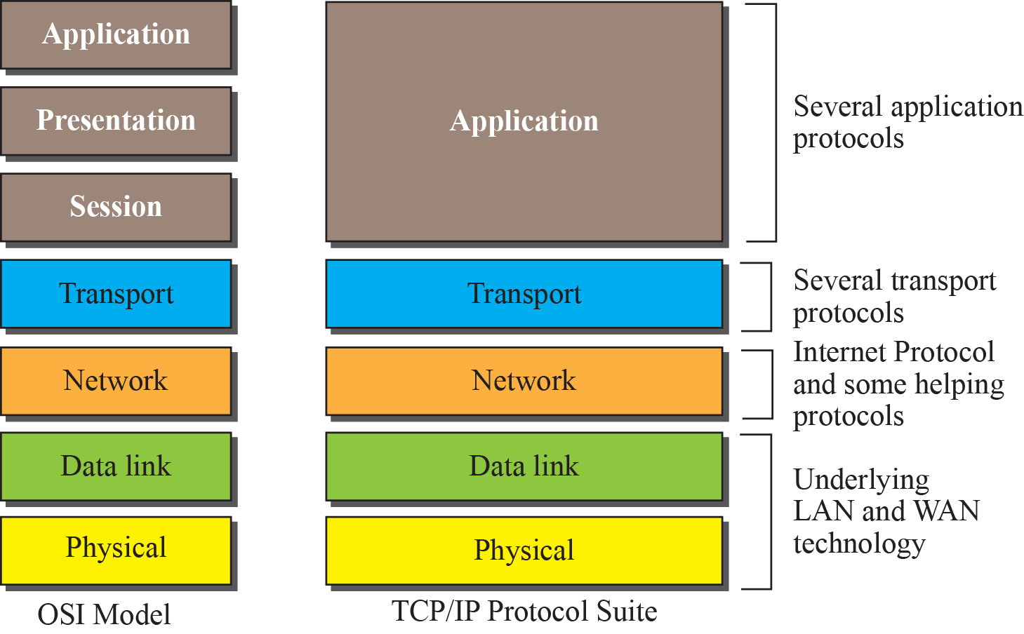
Figure 1.20: TCP/IP and OSI model
1.<number>
Notes:
1.#

Slide 43
The OSI Model
Lack of OSI Model’s Success
- TCP/IP in already implemented, up and running
- protocols for session and presentation layers are not clearly defined
- not a significant performance boost for switch over

Slide 44
    8-1 INTRODUCTION- Switching
A network is a set of connected devices. Whenever we have multiple devices, we have the problem of how to connect them to make one-to-one communication possible. The solution is switching.
A switched network consists of a series of interlinked nodes, called switches.
8.<number>
Notes:
8.#

Slide 45
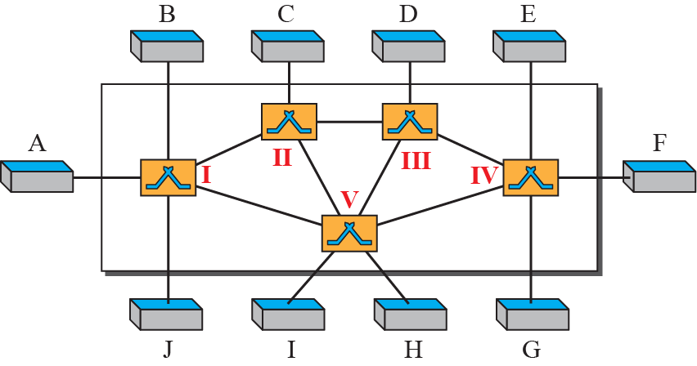
Figure 8.1: Switched network
Switches are the devices which are capable of creating temporary connections between two or more devices linked to the switch.
8.<number>
Notes:
8.#

Slide 46
8.8.2 Switching and TCP/IP Layers
Switching can happen at several layers of the TCP/IP protocol suite: at the physical layer, at the data-link layer, and at the network layer.
8.<number>
Notes:
8.#

Slide 47
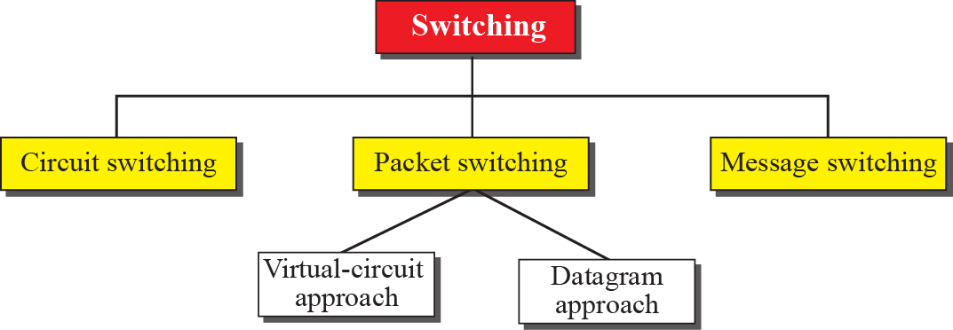
Figure 8.2: Taxonomy of switched networks
8.<number>
Notes:
8.#

Slide 48
    8-2 CIRCUIT-SWITCHED NETWORKS
A circuit-switched network consists of a set of switches connected by physical links.
A connection between two stations is a dedicated path made of one or more links.
However, each connection uses only one dedicated channel on each link. Each link is normally divided into n channels by using FDM or TDM
8.<number>
Notes:
8.#

Slide 49
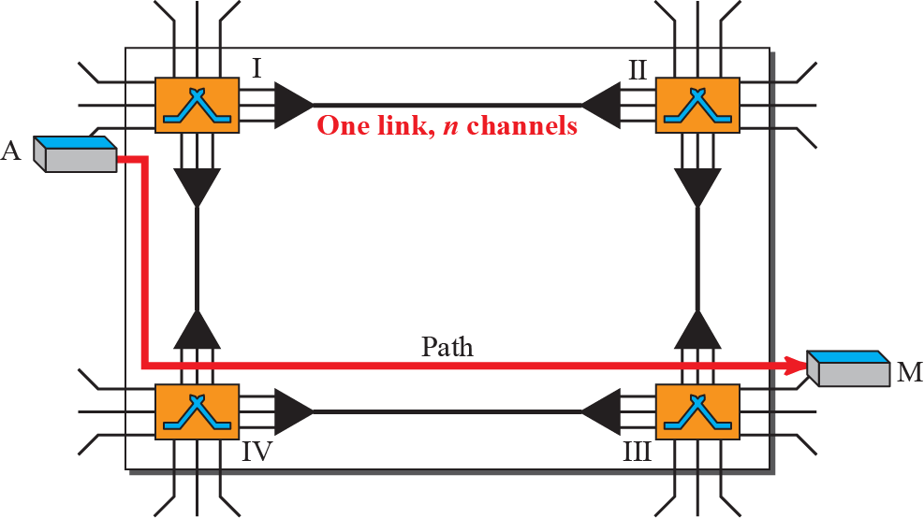
Figure 8.3: A trivial circuit-switched network
Circuit switching takes place at physical layer
Resource reservation happens in set up phase and dedicated to a communication throughout data transfer phase till teardown phase
Data are not packetized, it is continuous flow
No addressing involved during data transfer
8.<number>
Notes:
8.#

Slide 50
Example 8.1
As a trivial example, let us use a circuit-switched network to connect eight telephones in a small area. Communication is through 4-kHz voice channels. We assume that each link uses FDM to connect a maximum of two voice channels. The bandwidth of each link is then 8 kHz. Figure 8.4 shows the situation. Telephone 1 is connected to telephone 7; 2 to 5; 3 to 8; and 4 to 6. Of course the situation may change when new connections are made. The switch controls the connections.
8.<number>

Slide 51
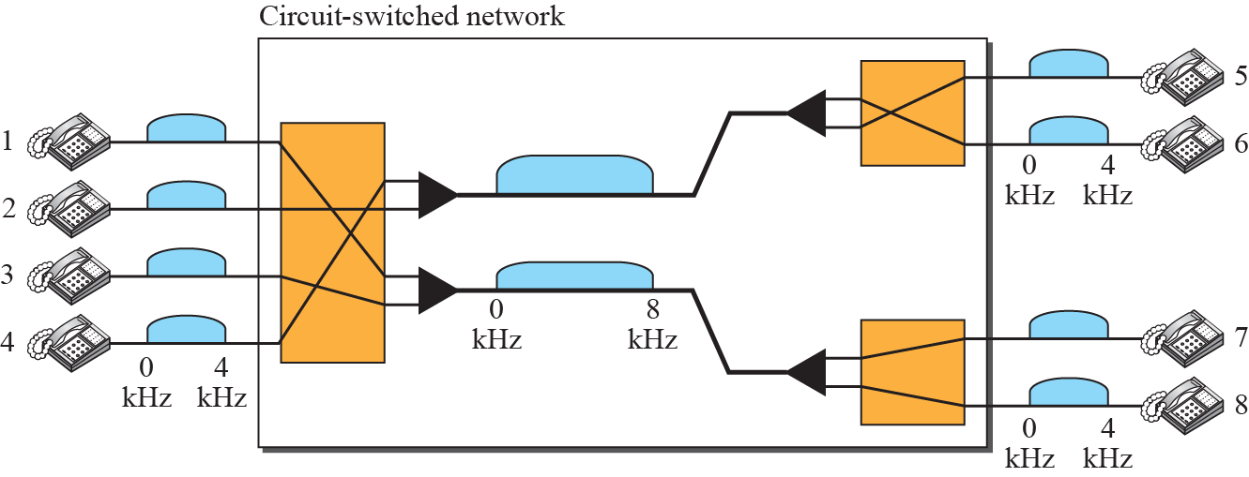
Figure 8.4: Circuit-switched network used in Example 8.1
8.<number>
Notes:
8.#

Slide 52
Example 8.2
As another example, consider a circuit-switched network that connects computers in two remote offices of a private company. The offices are connected using a T-1 line leased from a communication service provider. There are two 4 × 8 (4 inputs and 8 outputs) switches in this network. For each switch, four output ports are folded into the input ports to allow communication between computers in the same office. Four other output ports allow communication between the two offices. Figure 8.5 shows the situation.
8.<number>

Slide 53
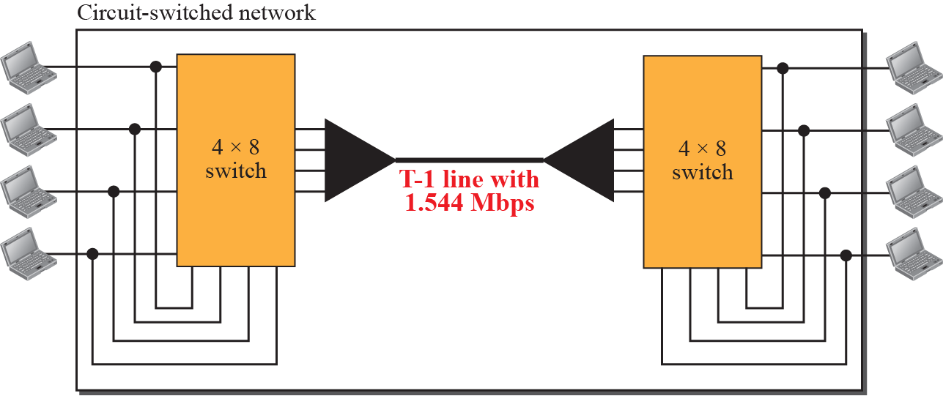
Figure 8.5: Circuit-switched network used in Example 8.2
8.<number>
Notes:
8.#

Slide 54
8.2.1 Three Phases
The actual communication in a circuit-switched network requires three phases: connection setup, data transfer, and connection teardown.
8.<number>
Notes:
8.#

Slide 55
8.2.2 Efficiency
It can be argued that circuit-switched networks are not as efficient as the other two types of networks because resources are allocated during the entire duration of the connection. These resources are unavailable to other connections. In a telephone network, people normally terminate the communication when they have finished their conversation.
8.<number>
Notes:
8.#

Slide 56
8.2.3 Delay
Although a circuit-switched network normally has low efficiency, the delay in this type of network is minimal. During data transfer the data are not delayed at each switch; the resources are allocated for the duration of the connection. Figure 8.6 shows the idea of delay in a circuit-switched network when only two switches are involved.
8.<number>
Notes:
8.#

Slide 57
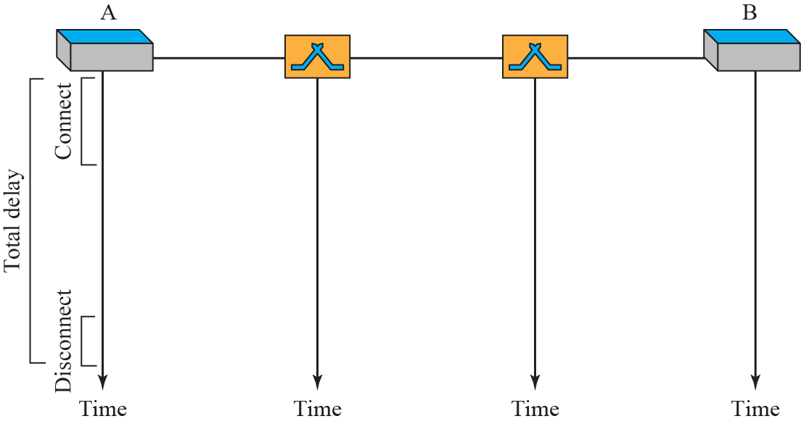
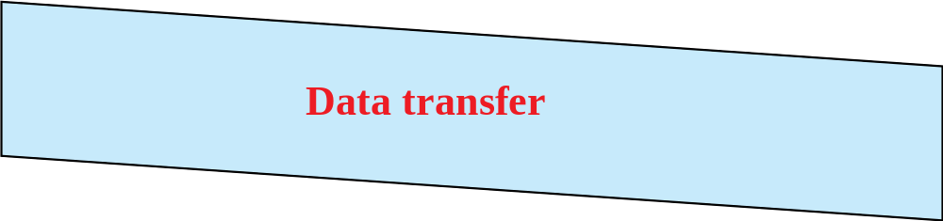
Figure 8.6: Delay in a circuit-switched network
8.<number>
Notes:
8.#

Slide 58
    8-3 PACKET SWITCHING
In data communications, we need to send messages from one end system to another. If the message is going to pass through a packet-switched network, it needs to be divided into packets of fixed or variable size.
No resource reservation, resources are allocated on demand (uses FCFS)
Delay may be there
8.<number>
Notes:
8.#

Slide 59
8.3.1 Datagram Networks
In a datagram network, each packet is treated independently of all others.
Packets in this approach are referred to as datagrams.
Done at network layer.
Packets belonging to same message may travel in different paths to the destination;
Packets may be delivered out of order.
Packets may be lost
It is referred to as connectionless networks
8.<number>
Notes:
8.#

Slide 60
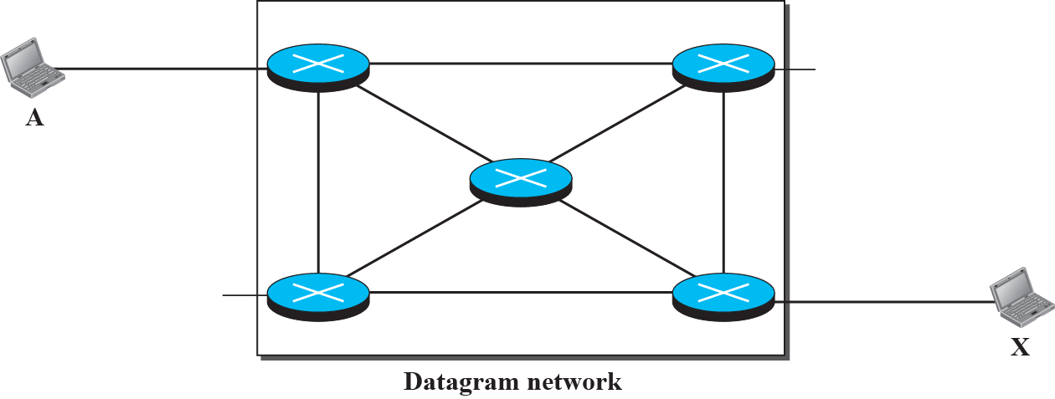






Figure 8.7: A Datagram network with four switches (routers)
8.<number>
Notes:
8.#

Slide 61
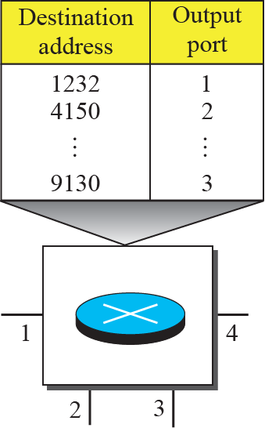
Figure 8.8: Routing table in a datagram network
A switch in datagram networks (Routers) uses the Routing table based on Destination address
Destination address remains same for the entire journey of the packet
Efficiency is better compared to circuit switched networks
8.<number>
Notes:
8.#

Slide 62
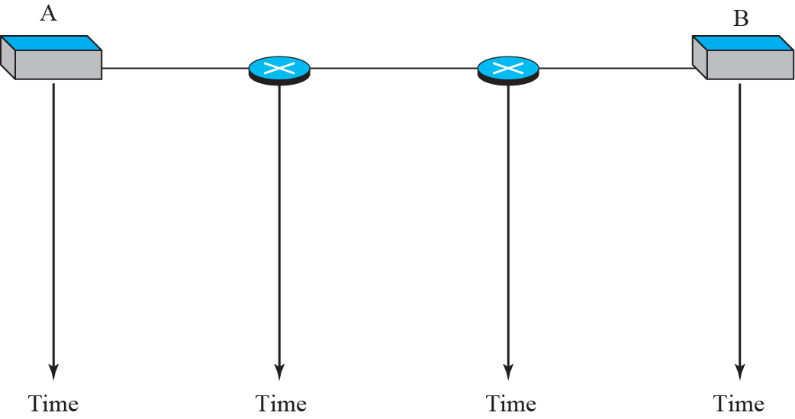




Figure 8.9: Delays in a datagram network
Total Delay = 3(Trans. Delay) + 3(Prop. Delay) + W1 + w2
8.<number>
Notes:
8.#

Slide 63
8.3.2 Virtual-Circuit Networks
A virtual-circuit network is a cross between a circuit-switched network and a datagram network. It has some characteristics of both.
Like Circuit switched network three phases
Resource can be reservation at set up phase or it could be allocated on demand
Data are packetized and each packet has local address (VCI)
All packets follow same path
Virtual circuit network in implemented in Datalink layer
8.<number>
Notes:
8.#

Slide 64
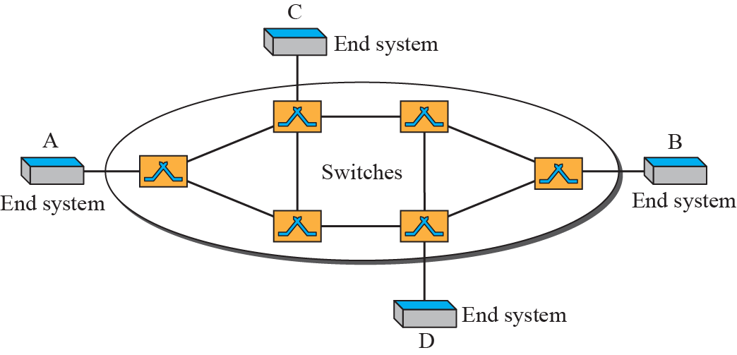
Figure 8.10: Virtual-circuit network
8.<number>
Notes:
8.#

Slide 65
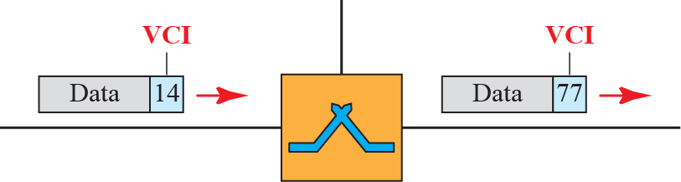
Figure 8.11: Virtual-circuit identifier
Global address is used for connection set up and VCI (local address) is used for Data transfer
8.<number>
Notes:
8.#

Slide 66
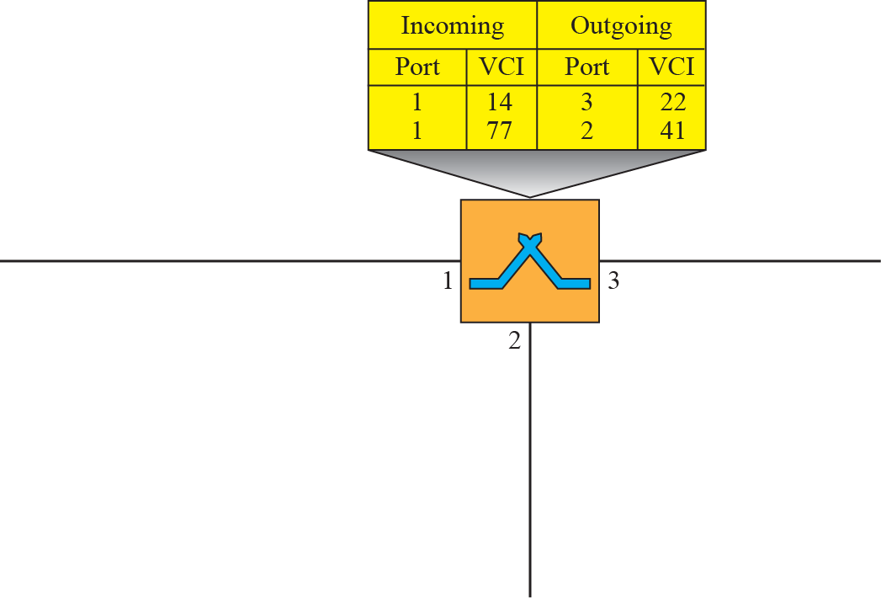



Figure 8.12: Switch and table for a virtual-circuit network
8.<number>
Notes:
8.#

Slide 67
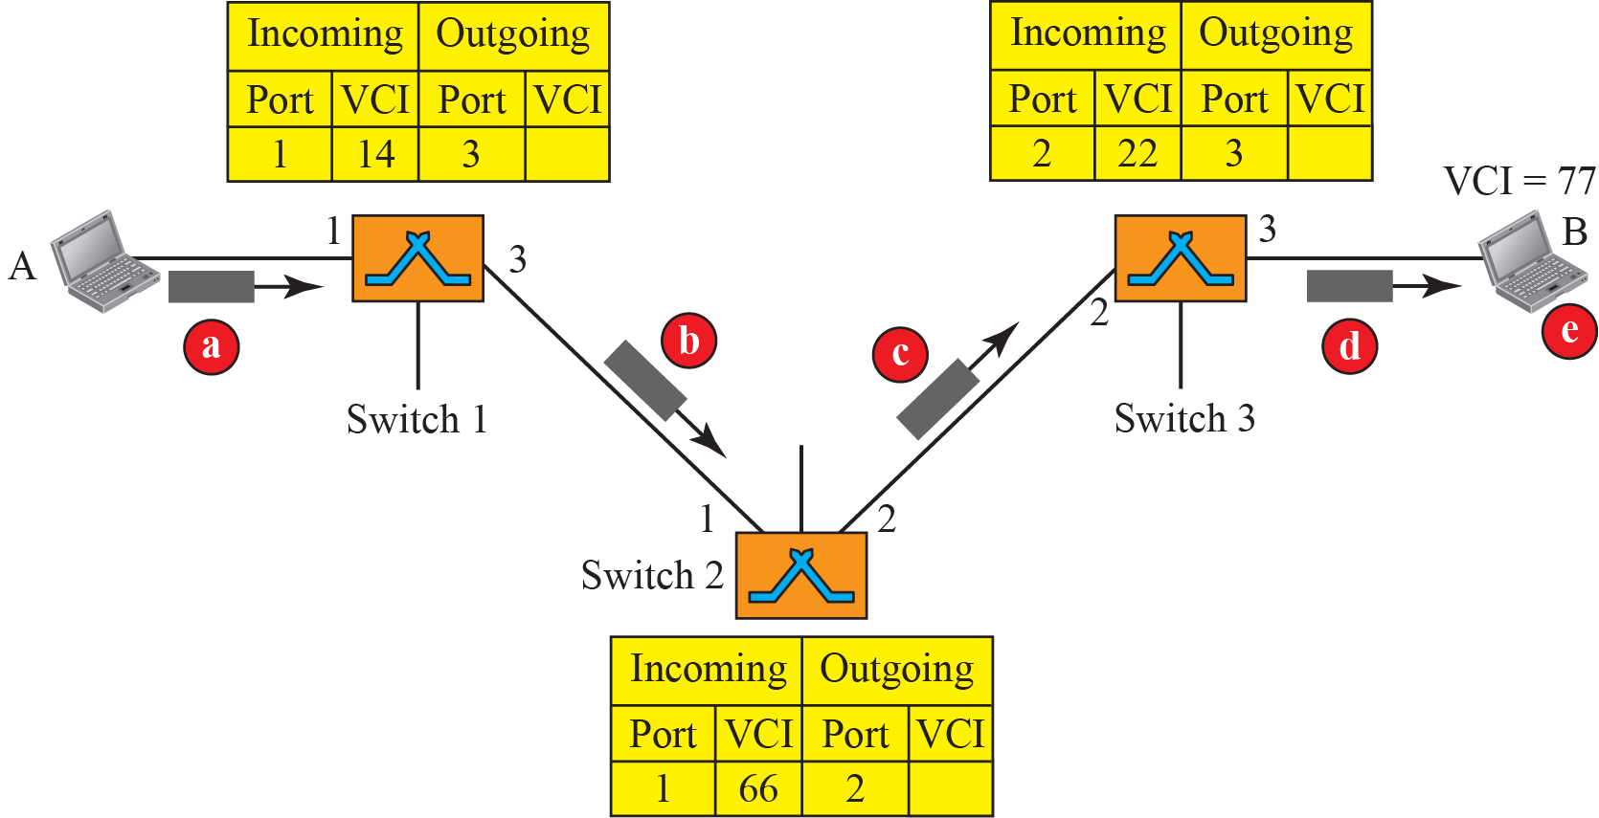
Figure 8.14: Setup request in a virtual-circuit network
In the set up phase switch acts as a packet switch
8.<number>
Notes:
8.#

Slide 68
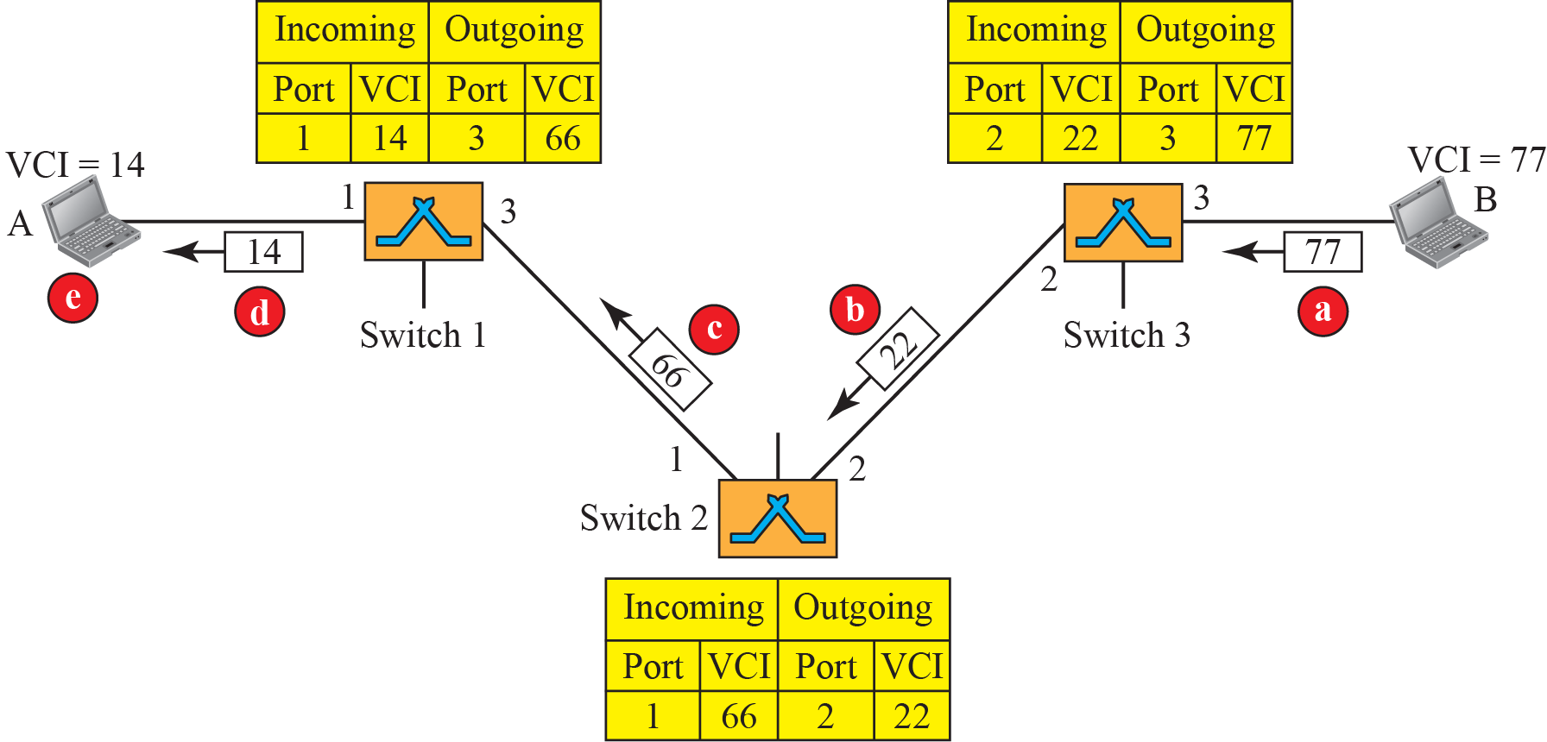
Figure 8.15: Setup acknowledgment in a virtual-circuit network
8.<number>
Notes:
8.#

Slide 69
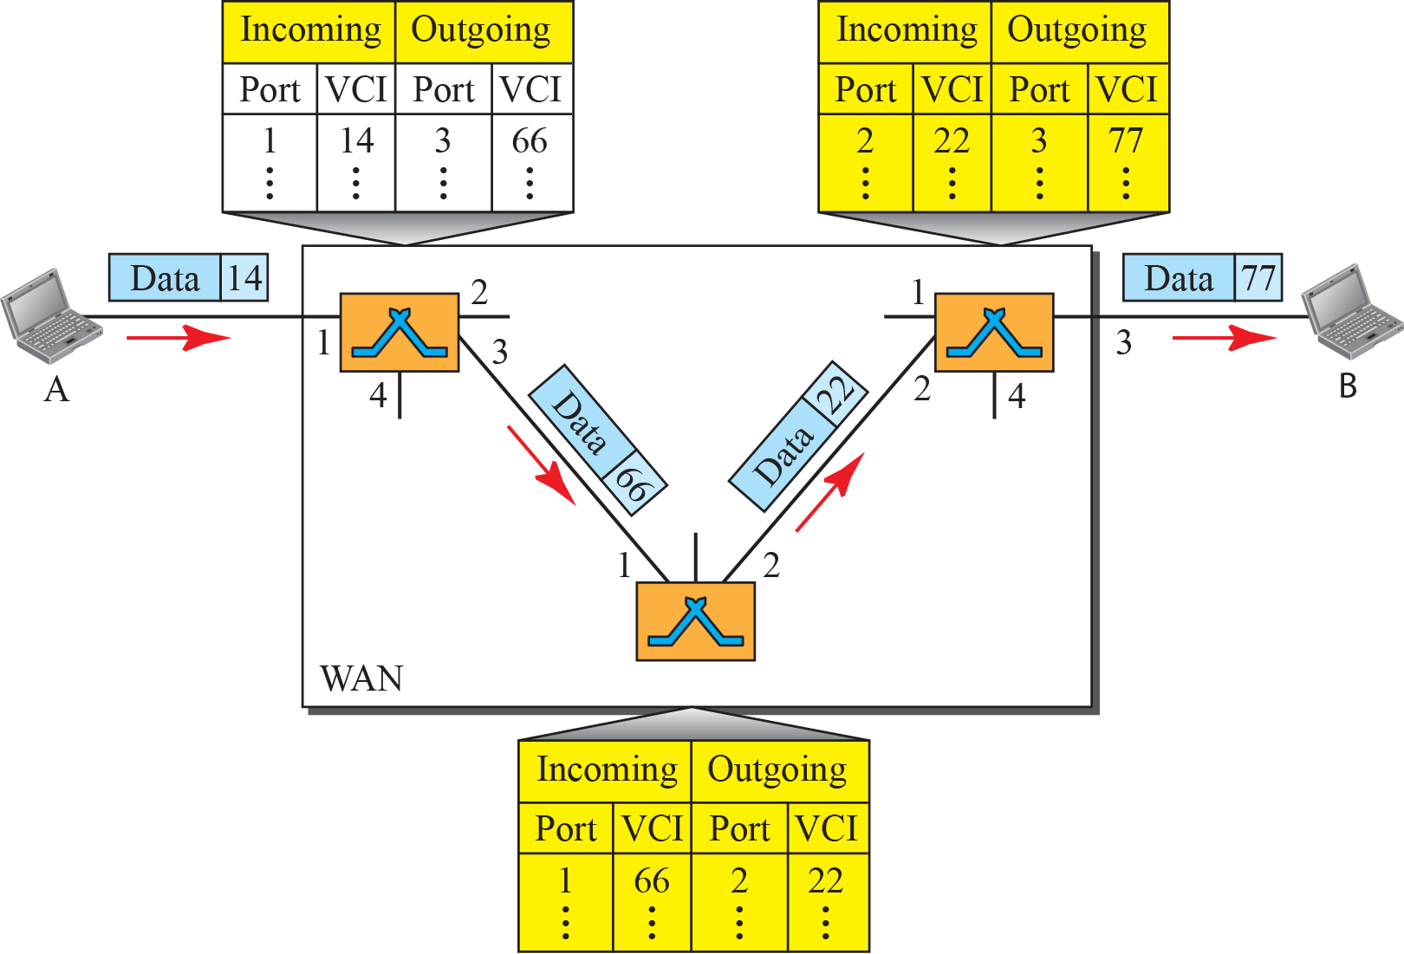
Figure 8.13: Source-to-destination data transfer in a circuit-switch
network
8.<number>
Notes:
8.#

Slide 70
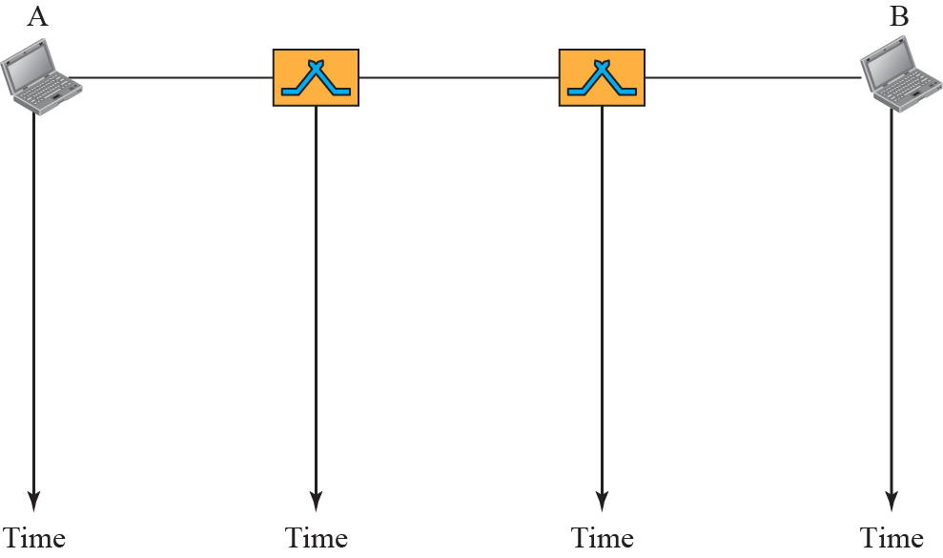


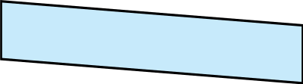

Figure 8.16: Delay in a virtual-circuit network
Total Delay = 3(Trans. Delay) + 3(Prop. Delay) + set up dalay + Teardown delay
Used in switched WAN technology like ATM networks
8.<number>
Notes:
8.#

Slide 71
    8-4 STRUCTURE OF A SWITCH
We use switches in circuit-switched and packet-switched networks. In this section, we discuss the structures of the switches used in each type of network.
8.<number>
Notes:
8.#

Slide 72
8.4.1 Structure of Circuit Switches
Circuit switching today can use either of two technologies: the space-division switch or the time-division switch.
In space-division switching the paths in the circuit are separated from one another spatially.
It can be used in both analog and digital networks
8.<number>
Notes:
8.#

Slide 73
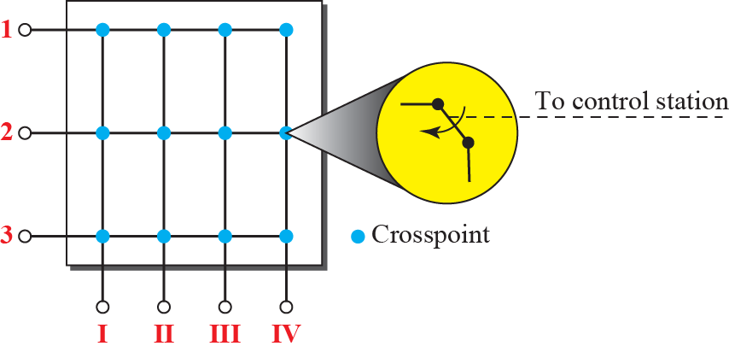
Figure 8.17: Crossbar switch with three inputs and four outputs
It connects n inputs to m outputs in a grid, using transistors (electronic micro switches) at each crosspoint.
Limitations: No of crosspoints too high
only 25% in use at a given time
8.<number>
Notes:
8.#

Slide 74
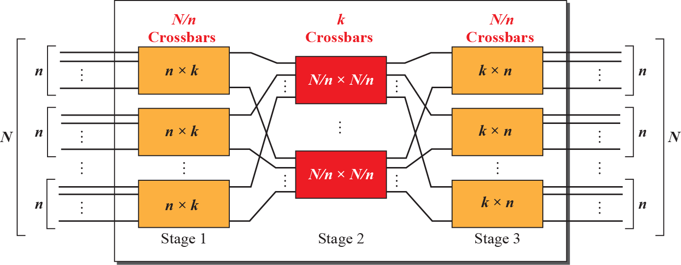
Figure 8.18: Multistage switch
It combines crossbar switches in several stages (normally three)
Three stage switch follows three steps
8.<number>
Notes:
8.#

Slide 75
Multistage Switch
Divide N input lines into groups, each of n lines. Each group use a crossbar of size n X k where k is the number of crossbars in the middle stage (N/n crossbars, each of size n X k crosspoints
Use k crossbars of size (N/n) X (N/n) in the middle stage
Use N/n crossbars, each of size k X n at the third stage
Total number of crosspoints =
N/n(n x k) +k( N/n x N/n) + N/n (k x n) =
2kN + k(N/n)²
1.<number>

Slide 76
Example 8.3
Design a three-stage, 200 × 200 switch (N = 200) with k = 4 and n = 20.
Solution
In the first stage we have N/n or 10 crossbars, each of size 20 × 4. In the second stage, we have 4 crossbars, each of size 10 × 10. In the third stage, we have 10 crossbars, each of size 4 × 20. The total number of crosspoints is
2kN + k(N/n)², or 2000
crosspoints. This is 5 percent of the number of crosspoints in a single-stage switch (200 × 200 = 40,000).
8.<number>

Slide 77
Multistage Switch
Drawback: blocking during periods of heavy traffic
In previous example, only 4 of the first 20 inputs can use the switch at a time. more than 4 results in blocking
Clos investigate a condition of non-blocking in multistage switches
k >= 2n – 1 and n >=(N/2)^{1/2}
Now the total number of crosspoints >= 4N [(2N)^{1/2} – 1]
1.<number>

Slide 78
Example 8.4
Redesign the previous three-stage, 200 × 200 switch, using the Clos criteria with a minimum number of crosspoints.
Solution
We let n = (200/2)1/2, or n = 10. We calculate k = 2n – 1 = 19. In the first stage, we have 200/10, or 20, crossbars, each with 10 × 19 crosspoints. In the second stage, we have 19 crossbars, each with 10 × 10 crosspoints. In the third stage, we have 20 crossbars each with 19 × 10 crosspoints. The total number of crosspoints is 20(10 × 19) + 19(10 × 10) + 20(19 × 10) = 9500. If we use a single-stage switch, we need 200 × 200 = 40,000 crosspoints. The number of crosspoints in this switch is 24 percent that of a single-stage switch.
8.<number>

Slide 79
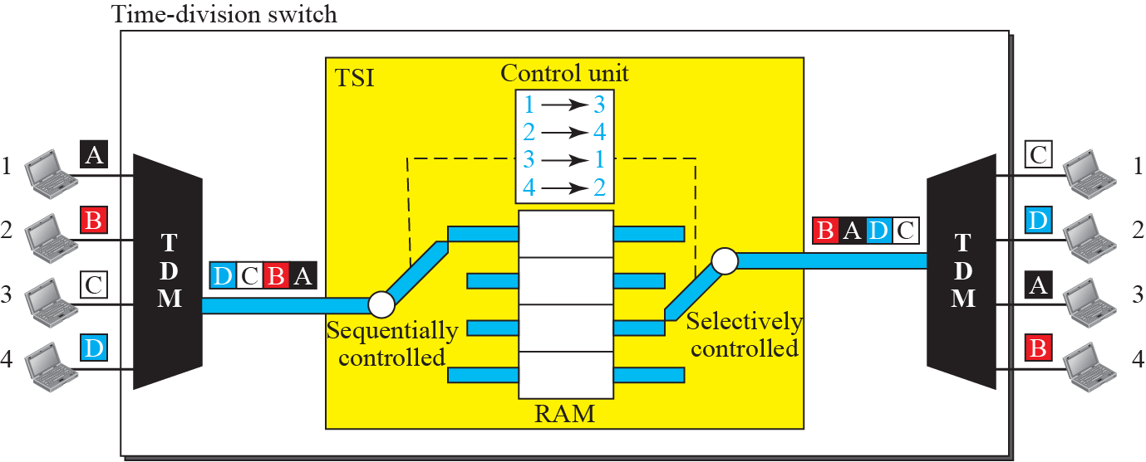
Time Division Switch
Time-slot interchange
Time-division switching uses TDM inside a switch. Most popular technology is TSI (Time Slot Interchange)
Here 4 input lines and 4 output lines. The size of each location is same as the size of the single time slot.
The RAM fills up with incoming data from time slots and they sent out based on the decisions of a control unit.
8.<number>`
Notes:
8.#

Slide 80
Time and Space division switch combination
Space division:
adv: It is instantaneous
Dis adv: Number of crosspoints
Time Division:
adv: No crosspoints
Dis adv: Processing each connection creates delays, each time slot must be stored in RAM and then retrieved and passed on
Solution: have the combination
1.<number>

Slide 81

Figure 8.20: Time-space-time switch
8.<number>
Notes:
8.#

Slide 82
8.4.2 Structure of Packet Switches
A switch used in a packet-switched network has a different structure from a switch used in a circuit-switched network.
We can say that a packet switch has four components: input ports, output ports, the routing processor, and the switching fabric, as shown below.
8.<number>
Notes:
8.#

Slide 83

Figure 8.21: Packet switch components
8.<number>
Notes:
8.#

Slide 84

Figure 8.22: Input port
Decapsulation
It has two processors and a queue. Input port does decapsulation when it receives the packet.
8.<number>
Notes:
8.#

Slide 85

Figure 8.23: Output port
Encapsulation
Output port does encapsulation while sending the packet.
8.<number>
Notes:
8.#

Slide 86
Routing processor
It does network layer functionality.
It does table look up (comparing the Destination address and deciding where to forward the Data Packet)
1.<number>

Slide 87
Switching Fabric
Most important component of a Packet switch
Used to move the packet from the input queue to the output queue
It affect the speed of switch (delay)
Variety of fabrics available
- crossbar switch (already discussed)
- Banyan switch
- Batcher-Banyan switch
1.<number>

Slide 88

Figure 8.24: A banyan switch(a multistage switch)
For n inputs and n outputs, we have log ₂ n stages with n/2 micro switches at each stage
They route packets from higher order bit to lower order
The following is an 8 input, 8 output switch. No. of stages = log₂ (8) = 3
8.<number>
Notes:
8.#

Slide 89


Figure 8.25: Example of routing in a banyan switch (Part a)
8.<number>
Notes:
8.#

Slide 90


Figure 8.25: Example of routing in a banyan switch (Part b)
Problem : internal Collisions
8.<number>
Notes:
8.#

Slide 91

Figure 8.26: Batcher-banyan switch
Batcher switch is used for sorting incoming packets according to their final destination
Trap module prevents duplicate packets going to same destination at the same time
8.<number>
Notes:
8.#

Slide 92
    13-1 ETHERNET PROTOCOL
In the TCP/IP Protocol suite The data-link layer and the physical layer are the territory of the local and wide area networks.
It will accept all standard protocols in these layers.
LAN – limited geographical area
goal –resource sharing
Several LAN technologies in 80’s and 90’s –
Ethernet, Token Ring, Token Bus, FDDI, ATM etc
13.<number>
Notes:
13.#

Slide 93
    13-1 ETHERNET PROTOCOL
Only Ethernet survived till today (because of adaptation to changing times, simplicity and backward compatibility).
Ethernet can be in home networks, Enterprise networks and Data Center networks.
Today’s Ethernet:
- No CSMA/CD
- Ethernet in Home (PLC - power line communication
POE - Power over Ethernet)
- Ethernet in Enterprise – co exist with other LAN Technologies.
13.<number>
Notes:
13.#

Slide 94
13.13.1 IEEE Project 802
In 1985, the Computer Society of the IEEE started a project, called Project 802, to set standards to enable intercommunication among equipment from a variety of manufacturers.
Project 802 does not seek to replace any part of the OSI model or TCP/IP protocol suite. Instead, it is a way of specifying functions of the physical layer and the data-link layer of major LAN protocols.
The relationship of the 802 Standard to the TCP/IP protocol suite is shown below
13.<number>
Notes:
13.#

Slide 95

Figure 13.1: IEEE standard for LANs
Data link layer is divided into two sub layers LLC and MAC
LLC – flow control, error control and part of Framing. It provides a single link layer control for all IEEE LANs.
MAC – Access method for each LAN, part of Framing function
13.<number>
Notes:
13.#

Slide 96

13.13.2 Ethernet Evolution
The Ethernet LAN was developed in the 1970s by Robert Metcalfe and David Boggs.
Since then, it has gone through four generations: Standard Ethernet (10 Mbps), Fast Ethernet (100 Mbps), Gigabit Ethernet (1 Gbps), and 10 Gigabit Ethernet (10 Gbps)
13.<number>
Notes:
13.#

Slide 97
    13-2 STANDARD ETHERNET
We refer to the original Ethernet technology with the data rate of 10 Mbps as the Standard Ethernet.
Although most implementations have moved to other technologies in the Ethernet evolution, there are some features of the Standard Ethernet that have not changed during the evolution.
We discuss this standard version first.
13.<number>
Notes:
13.#

Slide 98
13.2.1 Characteristics
Let us first discuss some characteristics of the Standard Ethernet.
Connectionless (frames are independent)
Unreliable (frames may be lost)
If a frame found to be currupted, silently it drops the frame. (it is up to the upper layer to find it out)
13.<number>
Notes:
13.#

Slide 99


Figure 13.3: Ethernet frame
Frame format ?
Frame Length ?
Cut-through switching – no store and forward
13.<number>
Notes:
13.#
v

Slide 100
13.2.2 Addressing
Each station on an Ethernet network (such as a PC, workstation, or printer) has its own network interface card (NIC).
The NIC fits inside the station and provides the station with a link-layer address.
The Ethernet address is 6 bytes (48 bits), normally written in hexadecimal notation, with a colon between the bytes. For example, the following shows an Ethernet MAC address:
13.<number>
Notes:
13.#

Slide 101

Example 13.1
Show how the address 47:20:1B:2E:08:EE is sent out online.
Solution
The address is sent left to right, byte by byte; for each byte, it is sent right to left, bit by bit, as shown below:
13.<number>

Slide 102


Figure 13.4: Unicast and multicast addresses
The unicast/multicast bit is the first bit which is transmitted or received.
13.<number>
Notes:
13.#

Slide 103
Example 13.2
Define the type of the following destination addresses:
4A:30:10:21:10:1A
47:20:1B:2E:08:EE
FF:FF:FF:FF:FF:FF
Solution
To find the type of the address, we need to look at the second hexadecimal digit from the left.
If it is even, the address is unicast.
If it is odd, the address is multicast.
If all digits are Fs, the address is broadcast.
13.<number>

Slide 104
Example 13.2 (continued)
a. This is a unicast address because A in binary is 1010
(even).
b. This is a multicast address because 7 in binary is 0111
(odd).
c. This is a broadcast address because all digits are Fs in
hexadecimal.
13.<number>

Slide 105



Figure 13.5: Implementation of standard Ethernet
13.<number>
Notes:
13.#

Slide 106
Types of Transmission
Standard Ethernet always does Broadcast
In Unicast, all stations receives the frame, but only the destination keeps and handles it. All others drop the frame
In Multicast group members accept, others drop
In broadcast, all stations receive the frame, handles it.
13.<number>

Slide 107
13.2.3 Access Method
Since the network that uses the standard Ethernet protocol is a broadcast network,
we need to use an access method to control access to the sharing medium.
The standard Ethernet chose CSMA/CD with 1-persistent method
13.<number>
Notes:
13.#

Slide 108
Access Method
Since standard Ethernet is a broadcast network, we need to control the access using one of the access methods.
If Station A is communicating to Station B:
A checks whether anybody else is is using the medium by checking the energy levels.
If A senses channel idle(energy level zero), starts frame transmission. Also continue to sense the medium (for 100 micro secs)
13.<number>

Slide 109
Access Method
After sending 512 bits (64 bytes) if no collision (no increase in energy level) it stops sensing the medium.
If there is a collision, it keeps the frame in buffer and sends a 48 bit jamming signal, to inform others.
After aborting, NIC enters binary exponential backoff:
  after mth collision, NIC chooses K at random from {0,1,2, …, 2^{m}-1}. NIC waits K·512 bit times, again starts sensing the medium.
  longer backoff interval with more collisions
13.<number>

Slide 110


Figure 13.12: A network with and without bridging
Separating the collision domains
13.<number>
Notes:
13.#

Slide 111


Figure 13.13: Collision domains
13.<number>
Notes:
13.#

Slide 112

Figure 13.14: Switched Ethernet
13.<number>
Notes:
13.#

Slide 113

Figure 13.15: Full – duplex switched Ethernet
No need for CSMA/CD
13.<number>
Notes:
13.#

Slide 114
        Thank You
1.<number>

